Slide 1

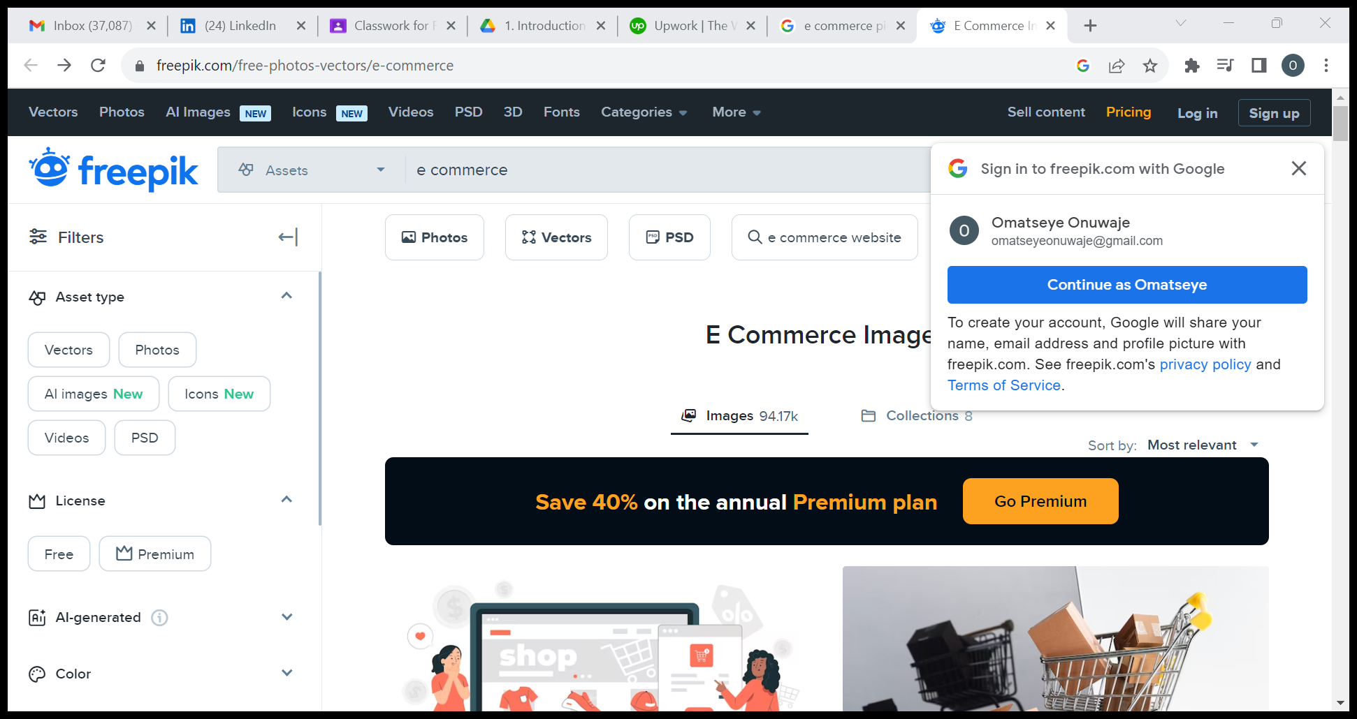
^{By} AWODEYI JOHN
CONNECTTEL CUSTOMER CHURN PREDICTION
Notes:
Introduction

Slide 2
Aim of the Project
The company aims to develop a robust customer churn prediction system.
The goal is to accurately forecast customer churn and implement targeted retention initiatives.

Slide 3
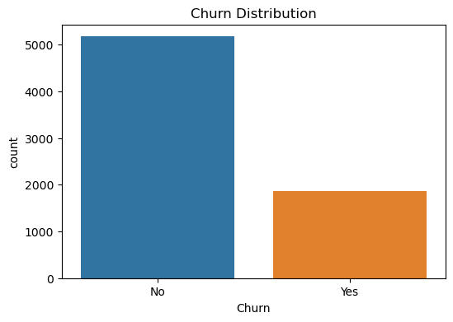
Exploratory Data Analysis
UNIVARIATE ANALYSIS
This analysis shows that the number of those that have churned the service are low compared to those that have not.
No - 5174
Yes - 1869

Slide 4
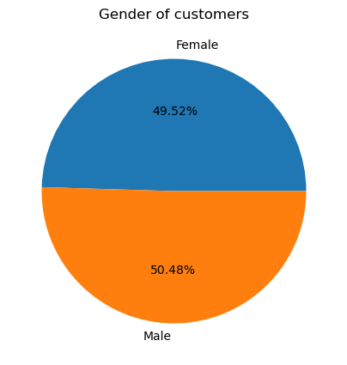
Exploratory Data Analysis
UNIVARIATE ANALYSIS
The percentage of the male gender that uses this services are just a little higher than that of the female gender.

Slide 5
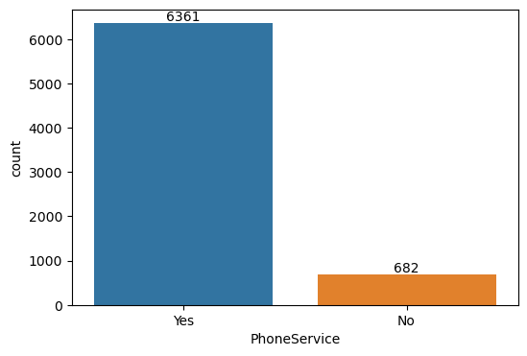
Exploratory Data Analysis
UNIVARIATE ANALYSIS
The number of those that have Phone service are more, compared to those that do not have.

Slide 6
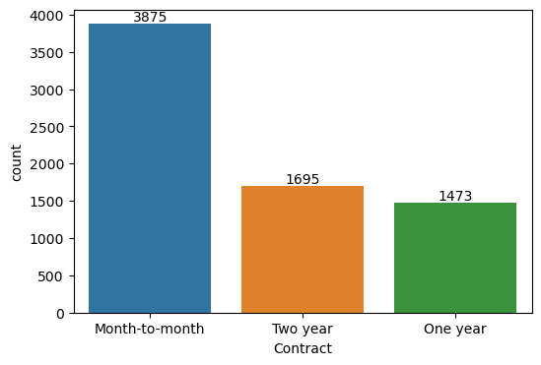
Exploratory Data Analysis
UNIVARIATE ANALYSIS
This analysis shows the most prevalent number of contract the customers subscribe to mostly.
More customers subscribes mostly to the monthly plan.

Slide 7
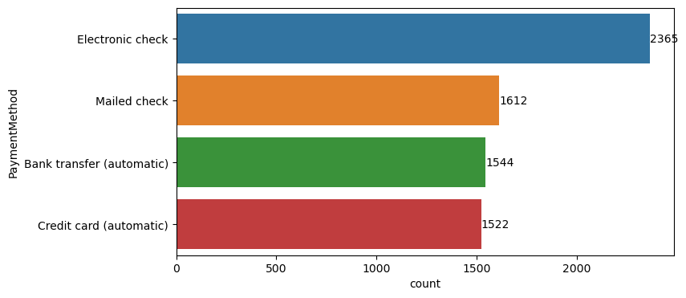
Exploratory Data Analysis
UNIVARIATE ANALYSIS
This analysis shows the payment method employed by customers.
Electronic check has the highest number of customers using the medium for payment.

Slide 8
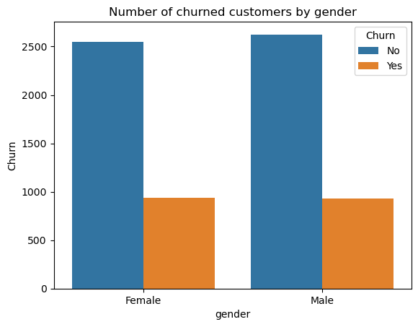
Exploratory Data Analysis
BIVARIATE ANALYSIS
This analysis shows the number of churned customers by gender.
gender Churn Count
Male No 2625
Female No 2549
Female Yes 939
Male Yes 930

Slide 9
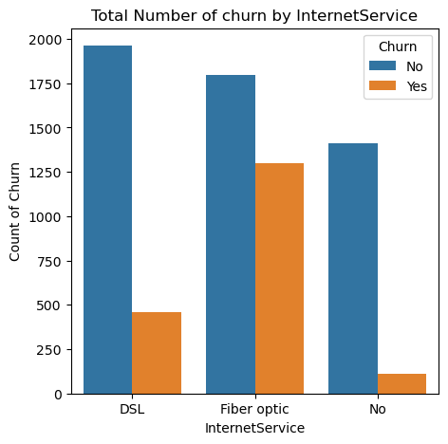
Exploratory Data Analysis
BIVARIATE ANALYSIS
This analysis shows the internet service that is mostly used by their number of churned customers.
Internet Service Churn Count
DSL No 1962
Fiber optic No 1799
No No 1413
Fiber optic Yes 1297
DSL Yes 459
No Yes 113

Slide 10
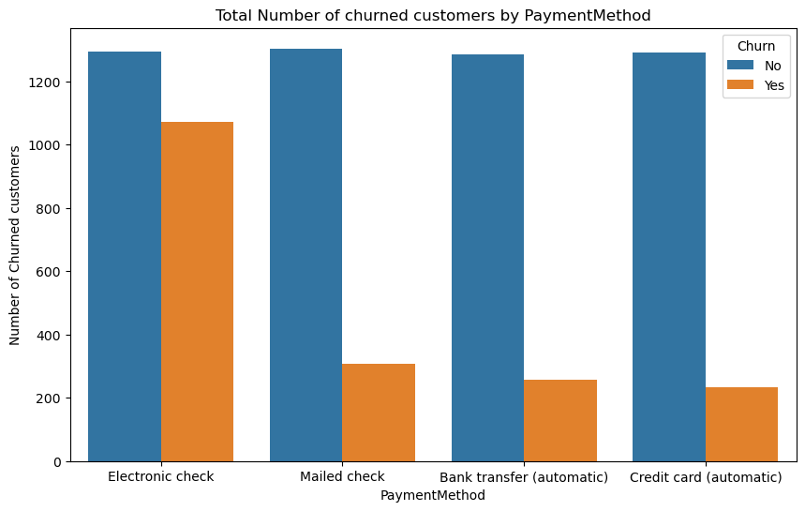
Exploratory Data Analysis
BIVARIATE ANALYSIS
This analysis shows the Payment Method that is mostly used by their number of churned customers.
PaymentMethod Churn Count
Mailed check No 1304
Electronic check No 1294
Credit card (automatic) No 1290
Bank transfer (automatic) No 1286
Electronic check Yes 1071
Mailed check Yes 308
Bank transfer (automatic) Yes 258
Credit card (automatic) Yes 232

Slide 11
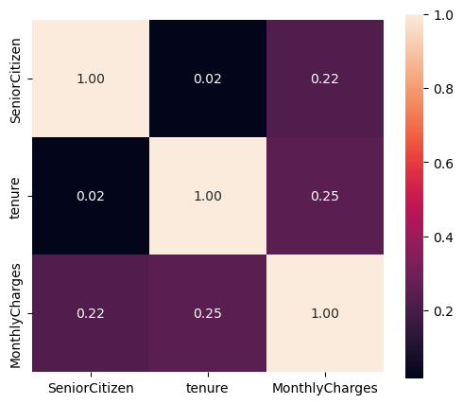
Exploratory Data Analysis
CORRELATION MATRIX
The heat map shows the relationship between the dependent variables and the independent variables

Slide 12
Model Building / Experimental Models
logistic regression accuracy score : 0.8102224325603408
Gradient Boosting accuracy score : 0.8102224325603408
Random Forest Classifier
Accuracy: 0.8054898248935163
Precision: 0.6285714285714286
Recall: 0.5416666666666666
F1-score: 0.5818921668362157
AUC-ROC: 0.7175210304942166

Slide 13
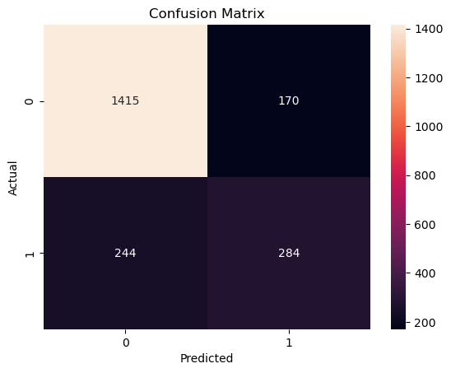
Model Evaluation
CONFUSION MATRIX
True Positive (TP): 1415 - Instances where the model correctly predicted 'Churn' (actual 'Churn' and predicted 'Churn').
True Negative (TN): 284 - Instances where the model correctly predicted 'Not Churn' (actual 'Not Churn' and predicted 'Not Churn').
False Positive (FP): 170 - Instances where the model incorrectly predicted 'Churn' (actual 'Not Churn' but predicted 'Churn').
False Negative (FN): 244 - Instances where the model incorrectly predicted 'Not Churn' (actual 'Churn' but predicted 'Not Churn').

Slide 14
Conclusion
Implement personalized retention strategies for high-risk customers.
Example: Send personalized offers, discounts, or targeted communication to high_risk customers
Monitor the effectiveness of retention initiatives and iterate as needed
Example: Track changes in churn rates, customer feedback, and ROI of retention strategies

Slide 15
THANK YOU
16

